Slide 1
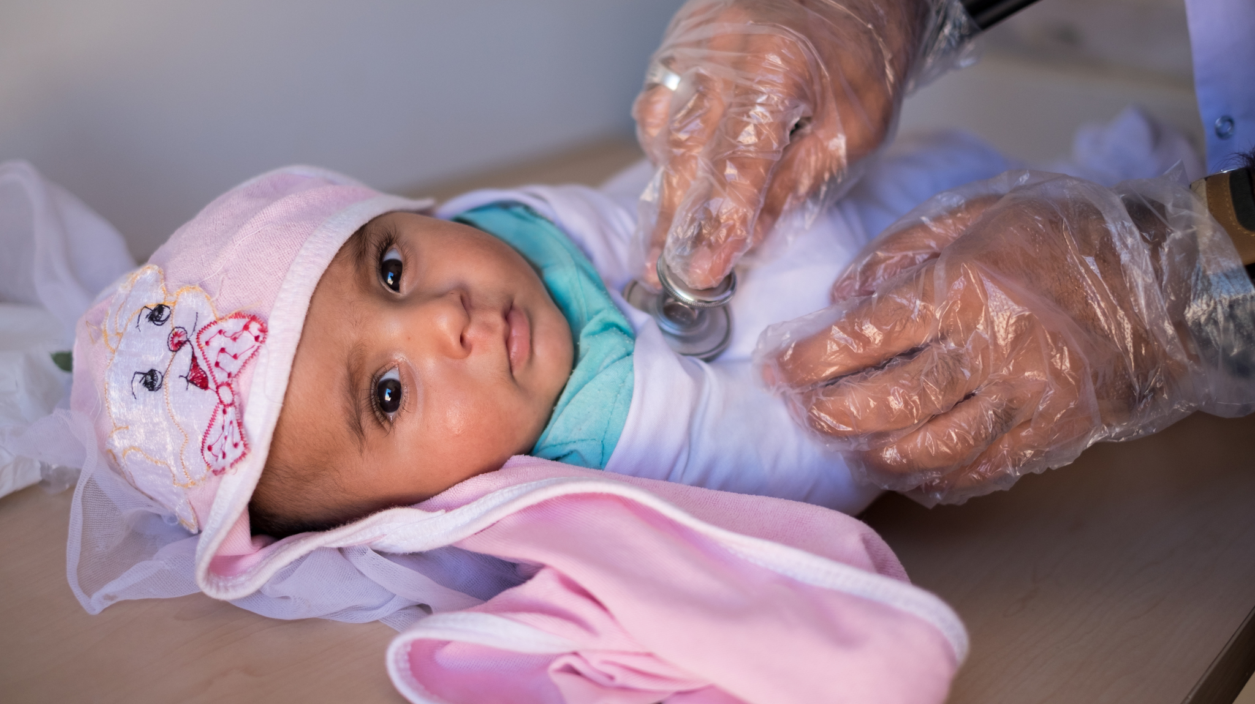
Born in Refuge: Helping the Helpless

